Slide 1
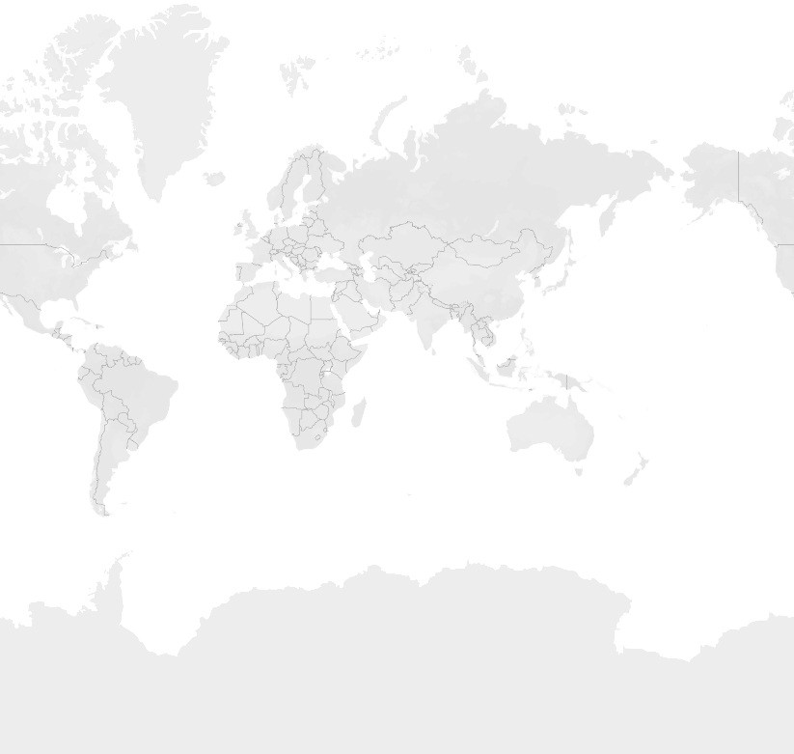

















Story 1
Economic freedom score
Top 40 ranking countries in the index | Bottom ranking countries by index | Index score based on unemployment rate | Index score based on ﬁnancial freedom | Index score based on population
2022 Score
0.00
84.40
© 2023 Mapbox © OpenStreetMap

Slide 2
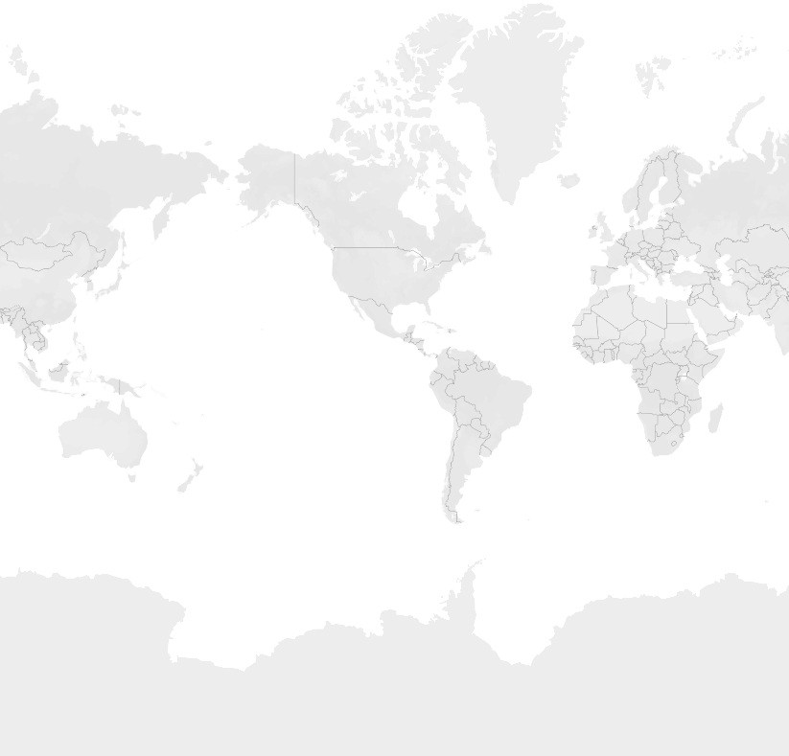
Story 1
Economic freedom score
Top 40 ranking countries in the index | Bottom ranking countries by index | Index score based on unemployment rate | Index score based on ﬁnancial freedom | Index score based on population
World Rank
1
40
© 2023 Mapbox © OpenStreetMap

Slide 3
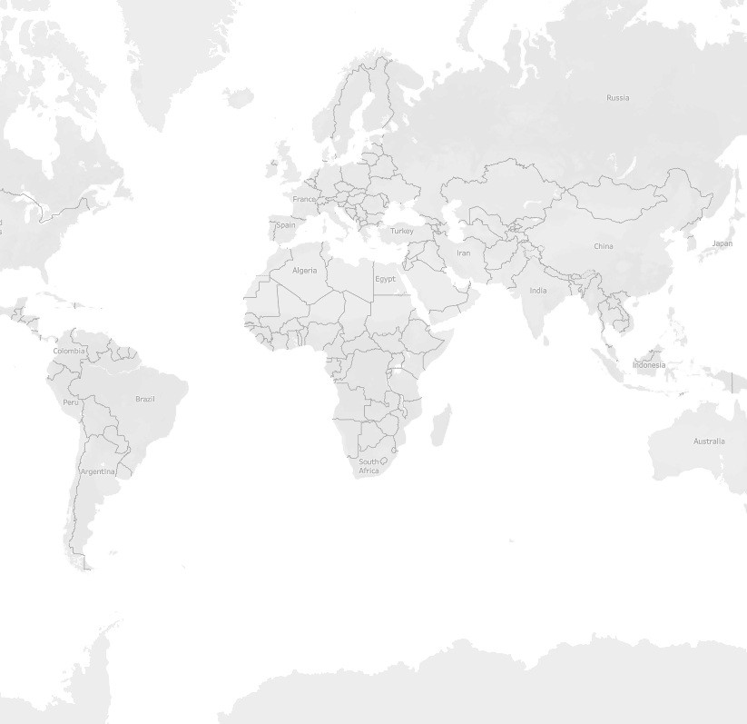




Story 1
Economic freedom score
Top 40 ranking countries in the index
Bottom ranking countries by index | Index score based on unemployment rate | Index score based on ﬁnancial freedom | Index score based on population
World Rank
127
177
© 2023 Mapbox © OpenStreetMap

Slide 4
Story 1
Economic freedom score
Top 40 ranking countries in the index
Bottom ranking countries by index
Index score based on unemployment rate | Index score based on ﬁnancial freedom | Index score based on population
Country Name
30
Measure Names Inﬂation (%) Unemployment (%)
2400
2200
25
2000
1800
1600
1400
20
Inﬂation (%)
Unemployment (%)
1200
15
1000
800
10
600
400
5
200
0
0
Afghanistan
Albania Algeria Angola Argentina Armenia Australia Austria Azerbaijan Bahamas Bahrain Bangladesh Barbados Belarus Belgium Belize Benin Bhutan Bolivia
Bosnia and Herzegovina
Botswana
Brazil Brunei Darussalam
Bulgaria Burkina Faso
Burma Burundi Cabo Verde Cambodia Cameroon Canada
Central African Republic
Chad Chile China

Slide 5
Story 1
Economic freedom score | Top 40 ranking countries in the index | Bottom ranking countries by index | Index score based on unemployment rate | Index score based on ﬁnancial freedom | Index score based on population
Tonga
Laos
Timor-Leste
Turkmenistan
Cuba
Region
Americas Asia-Paciﬁc Europe
Middle East and Nort.. Sub-Saharan Africa
Burma
China
Belarus
Sierra Leone
Liberia
Eritrea
Zimbabwe
Ethiopia
Congo Democratic Republic of the Congo
Iran
Sudan

Slide 6
Story 1
Economic freedom score
Top 40 ranking countries in the index
Bottom ranking countries by index
Index score based on unemployment rate
Index score based on ﬁnancial freedom
Index score based on population
Country Na..
2022 Score
Armenia
3.00
68.10
Azerbaijan Bahrain Bangladesh
Benin Chad China Egypt Ethiopia Greece Hungary
India Iran Jamaica Kazakhstan Korea North
Lebanon Liberia Malaysia Mexico Namibia
0
10
20
30 40
2022 Score
50
60
70 0
200
400 600 800 1000 1200 1400
Population (Millions)

